Slide 1


Lung Cancer Survival Prediction Using CT Scans, Clinical Data & Pathology Reports
Minor Project - Review 1 | Dept. of CSE (AI & ML)
Student 1: [M.Anosh Reddy] ([ENG23AM0157])
Student 2: [P.Devamshu] ([ENG23AM0171])
Student 3: [M.Ram Charan] ([ENG23AM0155])
Student 4: [N.Sai Vamshi] ([ENG23AM0165])
Guided By: [ MR. SRIRAMKUMAR R ]
[Assistant Professor], Dept. of CSE (AI & ML)
Dayananda Sagar University, Bengaluru

Slide 2
Objectives
To develop a multimodal AI model that predicts lung cancer patient survival by combining CT scan images, clinical tabular data, and pathology reports.
To improve prediction accuracy and early risk stratification compared to single- data-source models
To build a clinically interpretable risk scoring system that categorizes patients into low-, medium-, and high-survival risk groups for better treatment planning.

Slide 3
Introduction
Introduction:
Lung cancer is one of the leading causes of cancer-related deaths worldwide, mainly due to late diagnosis and inaccurate survival estimation. Early and precise survival prediction is crucial for personalized treatment planning.
Problem Statement:
To develop a predictive model that accurately estimates the survival probability of lung cancer patients using medical data (CT scans, clinical features, and pathology reports).
Gaps in Current Solutions:
1)Limited use of pathology text reports due to NLP complexity.
2) No personalization based on patient-specific risk factors.
3)Most models use single-modality data (only imaging or only clinical data)

Slide 4
Literature Review
S.No. | Details of Paper (Harvard Style) | Objectives, Dataset, Methodology / Models Used | Results / Advantages / Limitations
1 | Ardila, D. et al. (2019). End-to-end lung cancer detection on CT scans using deep learning. Nature Medicine, 25(6), pp.954-961. | Objective: Detect lung cancer malignancy from CT. Dataset: NLST (45,856 scans) + UK Biobank. Method: 3D CNN end-to-end trained on low-dose CT volumes; handles prior CT comparison; outputs malignancy probability. | AUC 0.944 vs radiologist AUC 0.856. Reduced false positives by 11%, false negatives by 5% vs radiologists. Limitation: Detection only — does not predict survival time or integrate clinical/pathology data.
2 | Katzman, J.L. et al. (2018). DeepSurv: Personalized treatment recommender system using a Cox proportional hazards deep neural network. BMC Medical Research Methodology, 18(1), p.24. | Objective: Predict patient survival using deep learning on tabular clinical data. Dataset: WHAS, SUPPORT, METABRIC, NLST clinical subset. Method: Deep Cox PH network — fully connected layers with log-hazard output; replaces linear Cox regression. | C-index improved 3-7% over linear CPH on all datasets including NLST lung subset. Proved deep learning can model non-linear survival relationships. Limitation: Tabular only — no CT imaging or pathology text integrated.

Slide 5
Literature Review
S.No. | Details of Paper (Harvard Style) | Objectives, Dataset, Methodology / Models Used | Results / Advantages / Limitations
3 | Yao, J. et al. (2020). Whole slide images based cancer survival prediction using attention guided deep multiple instance learning. Medical Image Analysis, 65, p.101789. | Objective: Lung cancer survival from whole slide pathology images using MIL. Dataset: TCGA-LUAD and TCGA-LUSC. Method: Attention-gated MIL aggregating patch-level ResNet-50 features from gigapixel WSI; Cox survival loss. | C-index 0.746 (LUAD), 0.762 (LUSC) — best WSI-only performance reported. Attention maps highlighted tumour microenvironment regions. Limitation: Pathology image only — CT scans and clinical tabular data not included.
4 | Chen, R.J. et al. (2021). Multimodal co-attention transformer for survival prediction in gigapixel whole slide images. ICCV 2021, pp.3995-4005. | Objective: Fuse WSI pathology images with genomics for lung cancer survival. Dataset: TCGA (LUAD, LUSC, 5 cancer types). Method: MCAT — hierarchical image pyramid transformer + co-attention with genomic token; cross-modal attention between image patches and gene expression. | SOTA C-index on LUAD (0.771) and LUSC (0.758). Co-attention outperformed concatenation by 4-6%. Attention heads interpretable per genomic pathway. Limitation: WSI + genomics only; CT radiology scans and clinical structured data not included.

Slide 6
Literature Review
S.No. | Details of Paper (Harvard Style) | Objectives, Dataset, Methodology / Models Used | Results / Advantages / Limitations
5 | Huang, Z. et al. (2020). SALMON: Survival Analysis Learning with Multi-Omics Neural Networks on Lung Cancer. npj Precision Oncology, 4(1), p.11. | Objective: Lung cancer survival via multi-omics fusion. Dataset: TCGA-LUAD (n=453), TCGA-LUSC (n=369). Method: Separate AE encoders for mRNA, miRNA, methylation, CNV; late concatenation + Cox PH head; modality contribution analysis. | C-index 0.692 (LUAD), 0.671 (LUSC) vs 0.621 unimodal baseline. Showed mRNA is dominant modality for lung. Limitation: Omics only — no CT imaging, clinical records, or pathology text; requires genomic profiling not available in all hospitals.
6 | Aerts, H.J.W.L. et al. (2014). Decoding tumour phenotype by noninvasive imaging using a quantitative radiomics approach. Nature Communications, 5, p.4006. | Objective: Extract radiomic features from CT to predict lung cancer outcome. Dataset: TCIA NSCLC-Radiomics (422 patients). Method: 440 radiomic features from CT tumour region (shape, texture, intensity); Cox regression with LASSO feature selection. | C-index 0.65 on validation cohort. Showed CT texture features like entropy and energy are prognostic. Widely cited as baseline for CT-based lung prognosis. Limitation: Hand-crafted features only — no deep learning, no other modalities.

Slide 7
Literature Review
S.No. | Details of Paper (Harvard Style) | Objectives, Dataset, Methodology / Models Used | Results / Advantages / Limitations
7 | Liu, Y. et al. (2020). Predict lung cancer survival based on multimodal data using graph neural networks. IEEE International Conference on Bioinformatics and Biomedicine, pp.557-560. | Objective: Lung cancer prognosis via multimodal GNN. Dataset: TCGA-LUAD (n=412). Method: Graph neural network fusing CT patch features + gene expression + clinical stage; patient similarity graph connecting cases with shared features. | C-index 0.718, outperformed single-modality models by 7-9%. Patient graph captured population-level survival patterns. Limitation: Requires genomics — not available in routine clinical workflow; no pathology text or XAI component.
8 | Mobadersany, P. et al. (2018). Predicting cancer outcomes from histology and genomics using convolutional networks. PNAS, 115(13), pp.E2970-E2979. | Objective: Histology image + genomic survival prediction. Dataset: TCGA-LUAD, TCGA-LGG. Method: CNN feature extraction from H&E patches fused with binary genomic risk score; Cox PH survival output head with hazard maps. | C-index improved 11% over clinical-only baseline. Hazard maps highlighted tumour core regions. Limitation: Binary genomic features only — clinical tabular variables and CT scans not incorporated; not lung-specific in methodology.

Slide 8
Literature Review
S.No. | Details of Paper (Harvard Style) | Objectives, Dataset, Methodology / Models Used | Results / Advantages / Limitations
9 | Steyaert, S. et al. (2023). Multimodal data fusion for cancer biomarker discovery with deep learning. Nature Machine Intelligence, 5, pp.351-362. | Objective: Benchmark multimodal fusion strategies for lung and other cancers. Dataset: TCGA (LUAD, LUSC among 14 cancer types). Method: Systematic comparison of 6 fusion strategies — early, late, intermediate, tensor, attention, cross-modal — across imaging and omics. | Intermediate cross-modal attention fusion consistently best — improved C-index 5-12% over unimodal on LUAD/LUSC. Provides benchmark framework. Limitation: CT radiology not included; only WSI imaging and omics benchmarked.
10 | Shen, W. et al. (2019). Mining prognosis index of brain metastases from lung cancer using artificial intelligence. JAMA Network Open, 2(12), p.e1917091. | Objective: Predict brain metastasis survival in lung cancer patients. Dataset: 1185 lung cancer patients with brain metastases. Method: Random forest + deep neural network on clinical variables; feature importance via SHAP; compared with established clinical prognosis indices. | AUC 0.81, outperformed traditional prognostic indices. SHAP identified primary tumour histology and number of lesions as top predictors. Limitation: Clinical data only — no CT imaging integration; restricted to brain metastasis subtype, not primary tumour survival.

Slide 9
Dataset
1] Clinical Dataset
Age
Gender
Smoking history
Tumor stage
Treatment details
Survival tim
3] Pathology Report Dataset
Histopathology diagnosis
Tumor type
Grade
Molecular markers
2] CT Image Dataset
Chest CT scans
Tumor region (Region of Interest – ROI)
Shape features
Texture features
Volume features

Slide 10
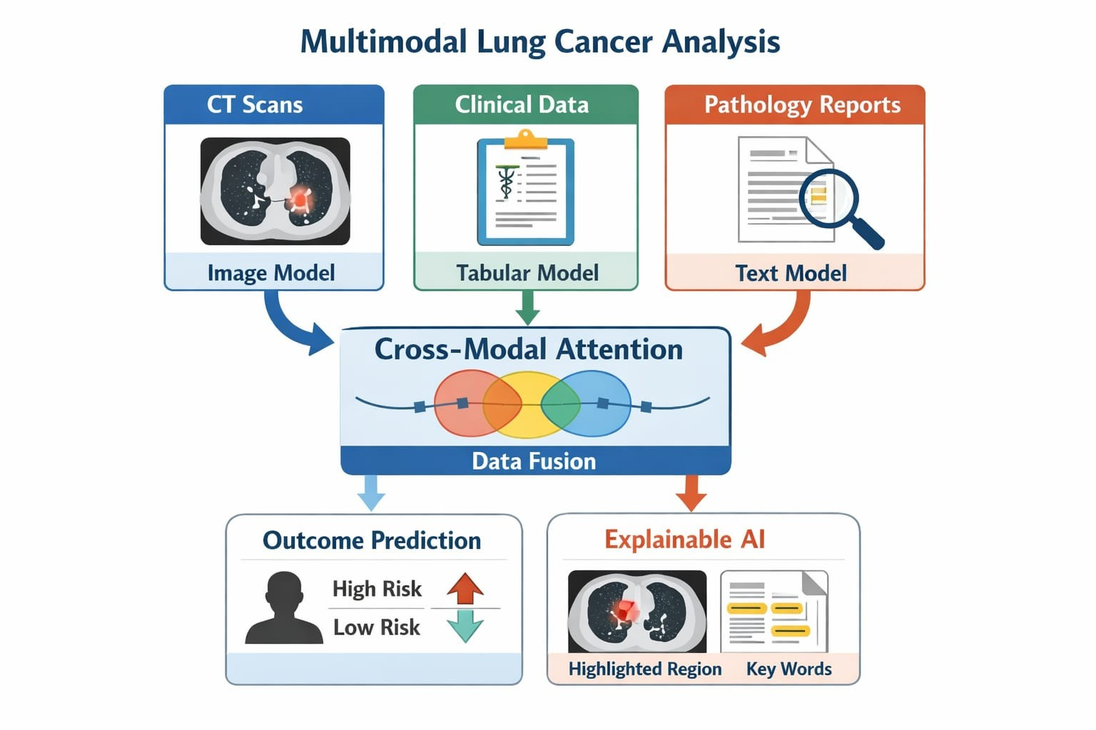
Methodology

Slide 11
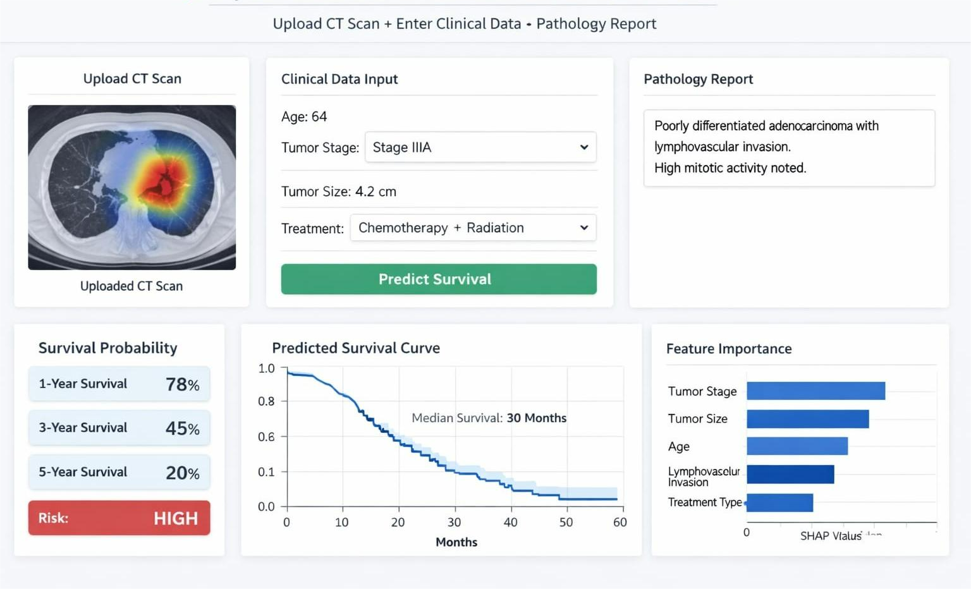
Results

Slide 12
Conclusions
Key Advantages:
CT scans show tumor size and shape
Clinical data shows patient health and smoking history
Pathology reports show microscopic tumor details
Combining all three gives better prediction accuracy
More reliable than using a single dataset
Limitations:
Requires high computing power
Some patients may not have all three data types
Data imbalance between datasets
Model needs testing on data from different hospitals
Future Scope:
Add genetic mutation data for better prediction
Develop a hospital-based prediction system
Improve model accuracy with more patient data
Deploy as a real-time clinical support tool

Slide 13
References
[1] Ardila, D. et al. (2019). End-to-end lung cancer detection on CT scans using deep learning. Nature Medicine, 25(6), pp.954-961.
[2] Katzman, J.L. et al. (2018). DeepSurv: Personalized treatment recommender system using a Cox proportional hazards deep neural network. BMC Medical Research Methodology, 18(1), p.24.
[3] Yao, J. et al. (2020). Whole slide images based cancer survival prediction using attention guided deep multiple instance learning. Medical Image Analysis, 65, p.101789.
[4] Chen, R.J. et al. (2021). Multimodal co-attention transformer for survival prediction in gigapixel whole slide images. ICCV 2021, pp.3995-4005.
[5] Huang, Z. et al. (2020). SALMON: Survival Analysis Learning with Multi-Omics Neural Networks on Lung Cancer. npj Precision Oncology, 4(1), p.11.
[6] Aerts, H.J.W.L. et al. (2014). Decoding tumour phenotype by noninvasive imaging using a quantitative radiomics approach. Nature Communications, 5, p.4006.
[7] Liu, Y. et al. (2020). Predict lung cancer survival based on multimodal data using graph neural networks. IEEE BIBM 2020, pp.557-560.
[8] Mobadersany, P. et al. (2018). Predicting cancer outcomes from histology and genomics using convolutional networks. PNAS, 115(13), pp.E2970-E2979.
[9] Steyaert, S. et al. (2023). Multimodal data fusion for cancer biomarker discovery with deep learning. Nature Machine Intelligence, 5, pp.351-362.
[10] Shen, W. et al. (2019). Mining prognosis index of brain metastases from lung cancer using artificial intelligence. JAMA Network Open, 2(12), p.e1917091.

Slide 14


